Slide 4
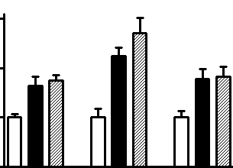
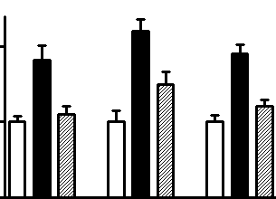
Supplementary Figure 1
A
3.0
***
***
2.0
**
**
*
*
mRNA content (AU)
1.0
0
Hnf1a
Hnf4a
Foxa2
B
***
2.0
**
##
***
*
##
###
mRNA content (AU)
1.0
0
Hnf1a
Hnf4a
Foxa2
Supplementary Figure 1. Quantification (RT-qPCR) of Hnf1a, Hnf4a and Foxa2 (codify HNF3B) mRNAs in samples of liver from control (C, white bars in panels A and B), obese type 2 diabetes mellitus (T2D, black bars in panels A and B), high-fat-fed T2D (HF-T2D, dashed bars in panel A) and phlorizin-treated T2D (Phl-T2D, dashed bars in panel B) mice. ANOVA, followed by Newman-Keuls post-test. *P<0.05, **P<0.01 and ***P<0.001 vs C; ##P<0.01 and ###P<0.001 vs T2D.

Slide 5
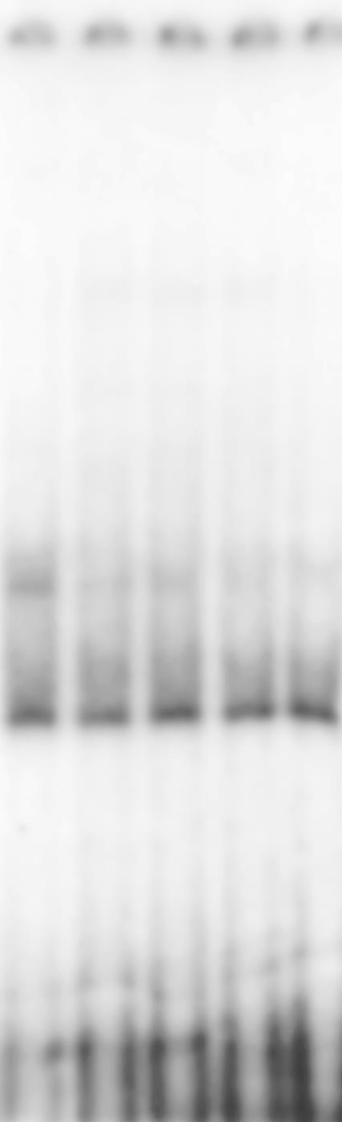
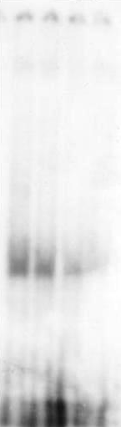
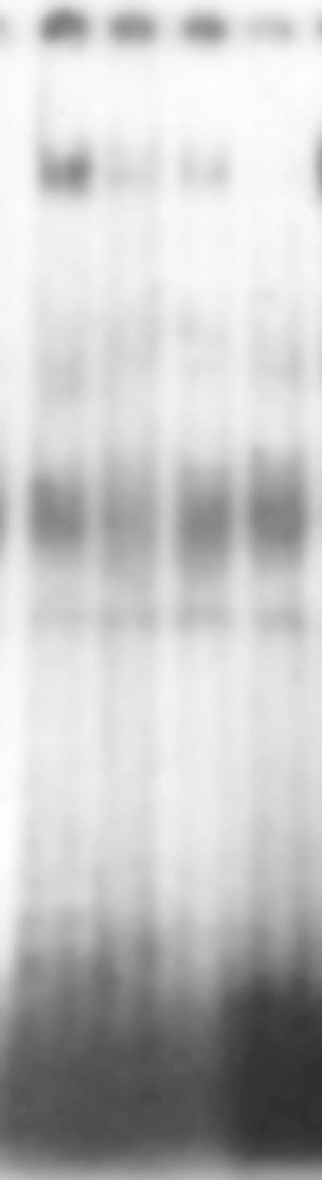
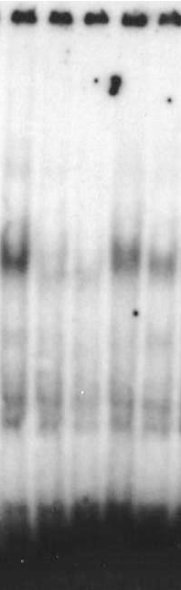
Supplementary Figure 2
HNF1A
HNF4A
HNF3B
NFKB
0x
10x
20x
50x
Ab
0x
50x
100x
Ab
0x
10x
20x
Ab
0x
10x
50x
0x
Ab
Supplementary Figure 2. EMSA analysis of HNF1A, HNF3B, HNF4A and NFKB in nuclear protein extract from liver samples. Specificity of the binding was checked by addition of 10- to 100-fold molar excess of unlabeled oligonucleotide, and of the specific antibodies (ab), as indicated at the top. For NFKB analysis (p50 and p65) anti-p65 ab was used. The arrows indicate the specific protein/DNA complex.

