Slide 1
Table S1. Quantitative PCR Array data. Complete list of 84 genes that were examined in the PCR array is presented. Fold change and p-value were calculated based on mock-treated chBMDC using software provided by the manufacturer (see Materials and Methods) at 16 hr post stimulation.

Slide 2
A
B
Figure S1. Venn diagram of chBMDC immune genes assayed by PCR array following 16 hr treatment of 200 ng/mL CpG-NP or free CpG. (A) Gene names are shown. (B) Number of gene in each set is shown.

Slide 3
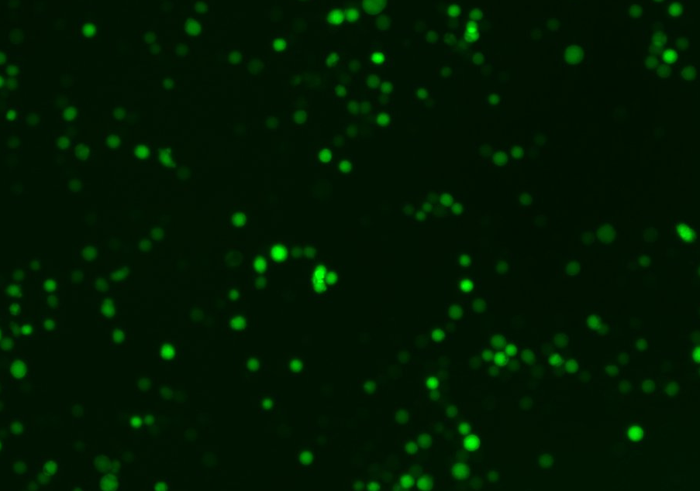
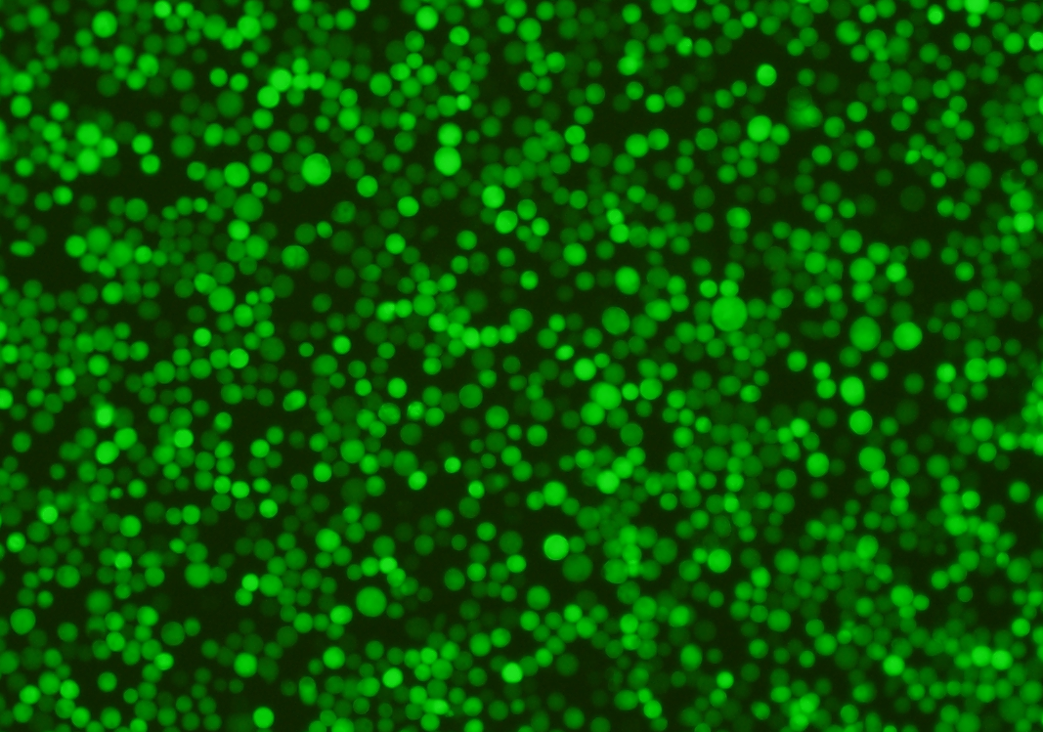
Day 1
Day 4
100 μm
100 μm
Figure S2. Expression of recombinant IBV RBD protein in Sf21 cells. The Sf21 cells were infected with the recombinant baculovirus carrying the RBD/IRES/EGFP expression cassette for 1 day and 4 days.

